Slide 1


Go digital business with SAP Business One
The single solution to streamline your business

Slide 2

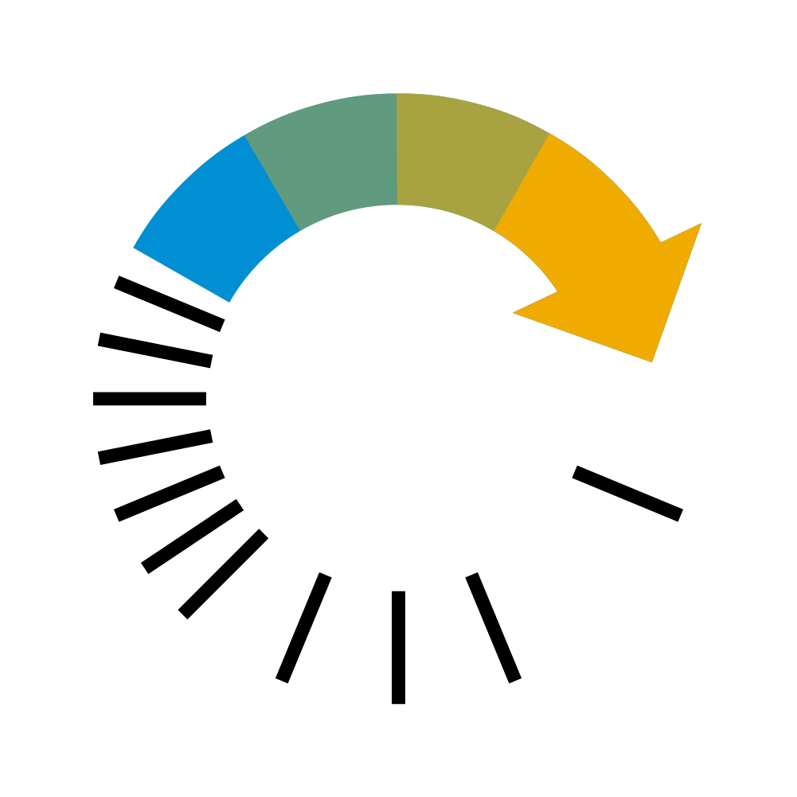





THE DIGITAL BUSINESS
BUSINESS INTEGRATION
IN MEMORY COMPUTING
BEST PRACTICE CORE PLATFORM
INDUSTRY EXTENSIBILITY
REAL-TIME ANALYTICS
MOBILE WORKFORCE
SOFTWARE AS A SERVICE

Slide 3







Management
& Administration
BEST PRACTICE CORE PLATFORM
Sales &
Service
Accounting
& Financials
Purchasing
& Operations
BEST PRACTICE CORE PLATFORM
Inventory
& Distribution
Project & Resource
management
Production
& MRP

Slide 4



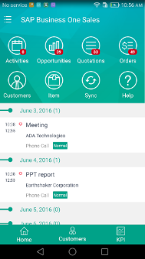
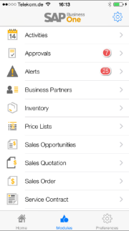
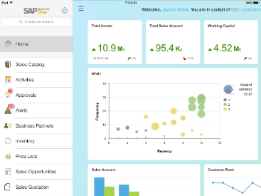
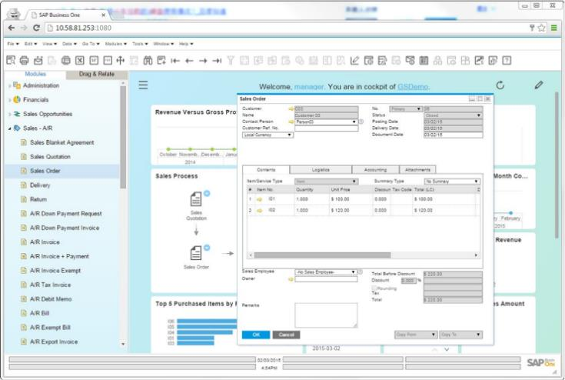
MOBILE WORKFORCE
Mobilize your sales and services teams by giving
them the flexibility to view and manage their tasks
and processes away from the office, at any time.
SOFTWARE AS A SERVICE
Access all the integrated business management
functionality of the SAP Business One application
within your web browser, delivered as a service.

Slide 5
























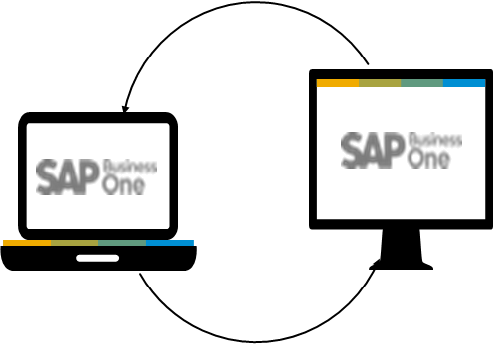
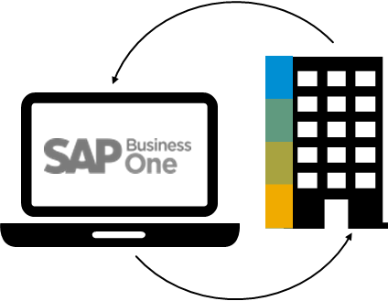

INDUSTRY EXTENSIBILITY
500+ integrated and certified solutions, built by partners that extend the application to meet your
industry specific requirements in
Automotive
Shipping
Healthcare
Agriculture
Engineering
Banking
Food & Beverage
Retail
High Tec
Chemicals
Industrial Machinery
Media
Consumer Products
Pharmacare
Aerospace & Defense
Construction
Wholesale Distribution
Oil, Gas & Energy
BUSINESS INTEGRATION
Allow your business application to evolve to a state-of-the-art Business Platform with the Business One integration framework (B1if).
Automated RFQ
Digital Campaigns
Point of Sale
E-commerce
Social
Networks
Collaboration
Ready-to-run
integrations
Business Networks
integrations
Ecosystem
integration
Intercompany & subsidiary integration

Slide 6
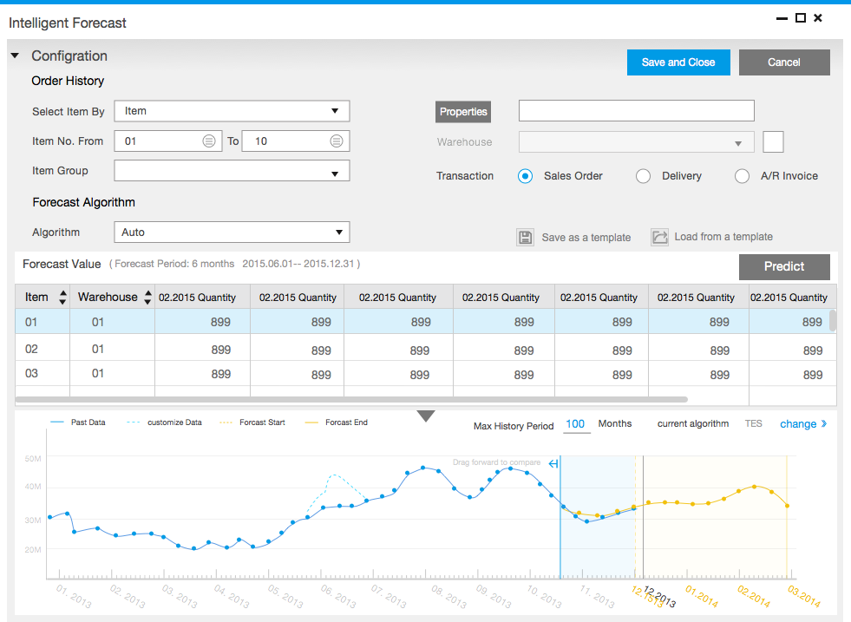
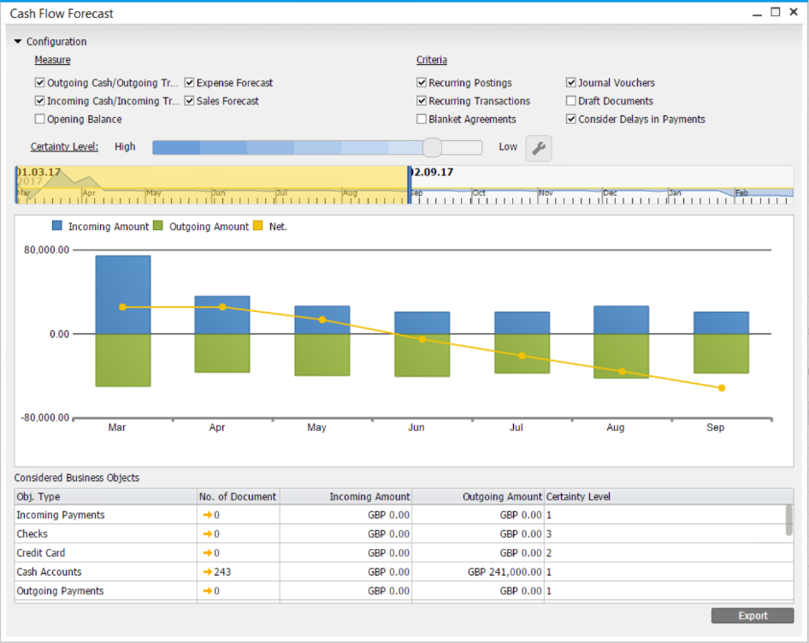
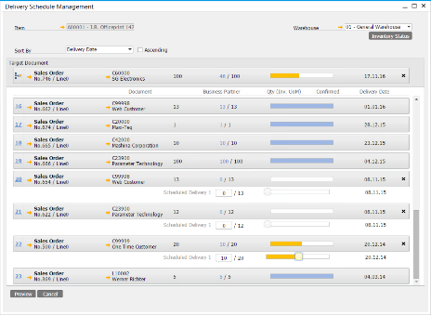
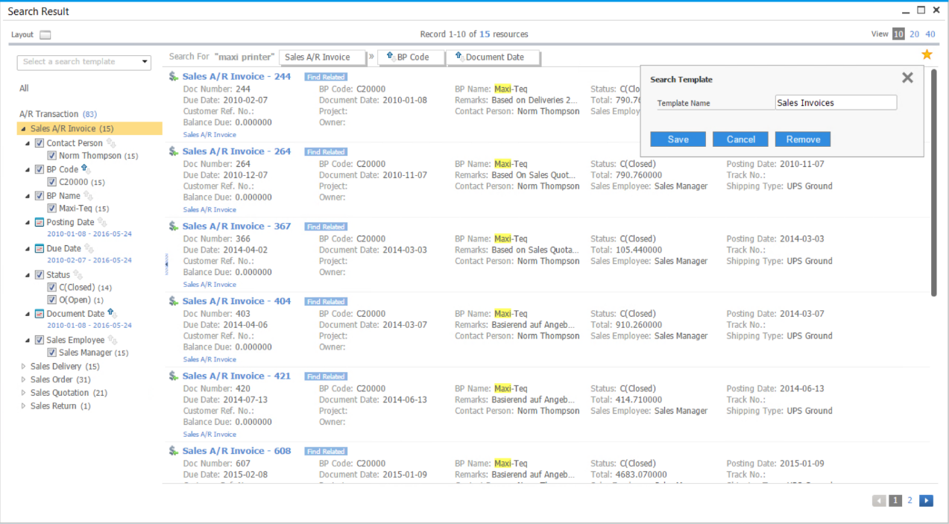
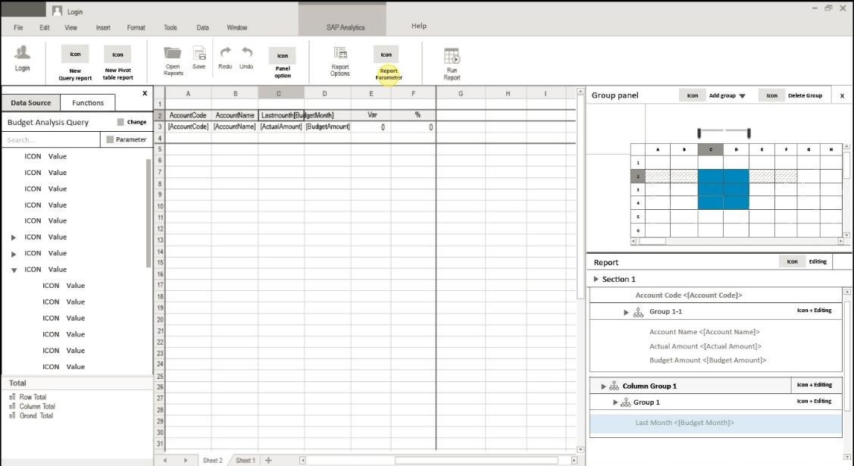
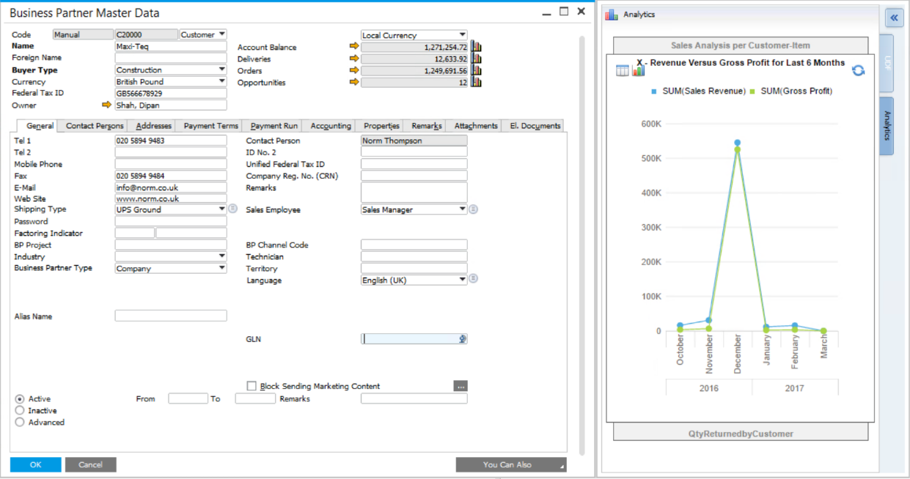
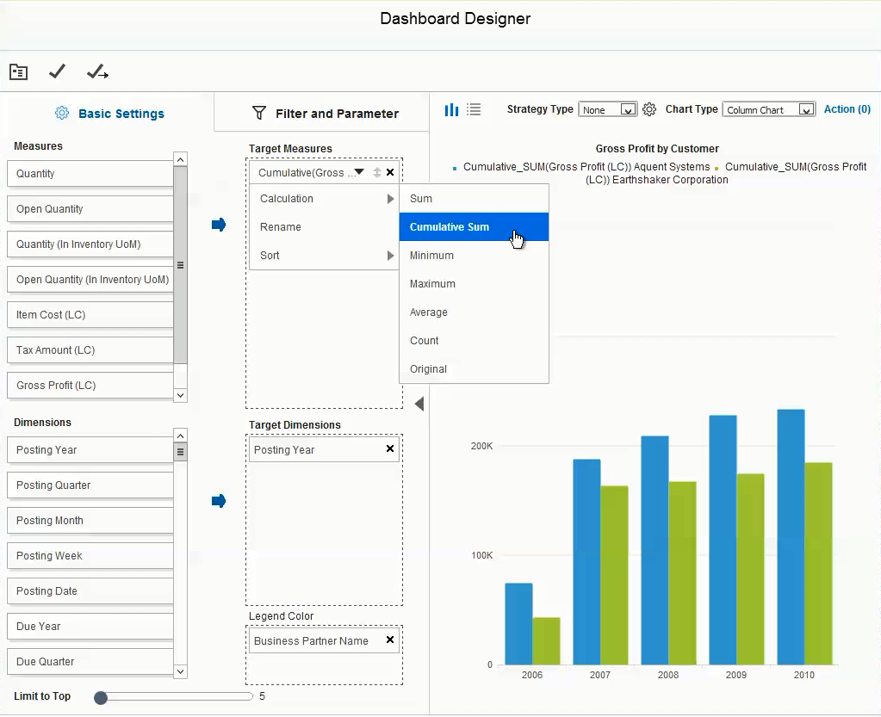
IN-MEMORY COMPUTING
Elevate and empower the user experience
by interacting with the various embedded
SAP HANA apps for strategic decision
making while improving productivity.
REAL-TIME ANALYTICS
Aid end users to access information freely, by tapping
into the ready-to-consume semantic layer, where
complex data is already mapped into familiar business
terms.

Slide 7



SAP’s best selling ERP solution by number of customers
Used by 60,000+ customers and more than 1,000,000 users
Available as 43 country localizations and in 27 languages
~300 Software Solution Partners with 500+ solutions
Implemented by more than 700 Value Added Resellers worldwide
SAP Business One is installed and used in 170 countries
360+ large enterprises are running SAP Business One in 2,400+ subsidiaries

Slide 8

Why explore ERP systems?
As your business changes, a solid underlying foundation is critical
Digital Economy
  You want to make the right business decisions at the right time, with real-time access to information.
You’re growing
  You are a fast growing company, and your needs are out-pacing your current system capabilities
  As your business grows, you need to put best-practice processes in place
  You need to automate your business processes, to increase productivity
Expansion
  If you’re expanding into new markets, you need business software that will enable, not hinder you
Notes:
<speaker notes>

Slide 9
A good ERP solution allows you to focus on running your business
Competitive advantage
  Become relevant in the global economy by implementing robust business process, thus allowing you to adapt to market changes, and anticipate business trends.
Connected business functions
  Finance systems are connected to procurement and production. CRM is connected to marketing, sales and service.
  Your entire business runs more smoothly by touching all areas of your business. This inspires natural cross departmental collaboration within your organization.
Easy access to data
  Integrated analytics and reports should always keep informed on the health of your business
  Better decisions can be made on the back of real-time data insights

Slide 10
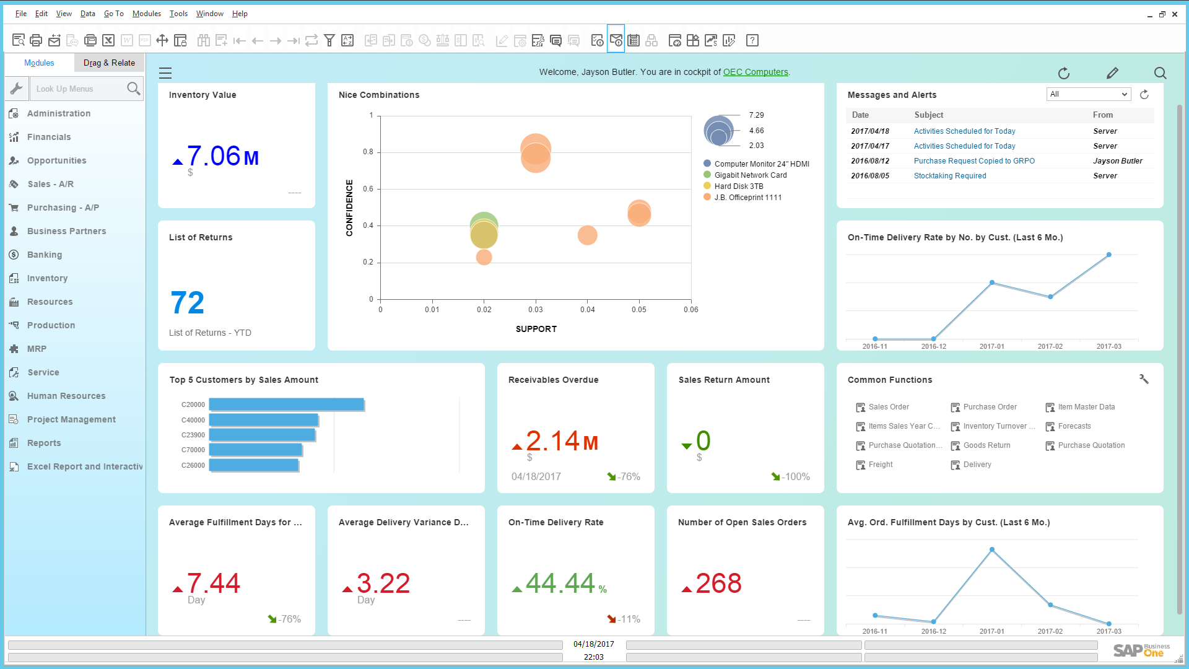
Meet SAP BusinessOne
Manage every aspect of your business through one, solid solution platform, trusted by over 60,000 companies in 170+ countries.
Capture business information in a single, scalable system
Streamline key processes
Make data driven decisions daily with integrated analytics
Connect departments from accounting and sales to service and purchasing
Give employees on-the-go access via intuitive mobile apps
Deploy on premise or in the cloud in as little as 2 to 8 weeks

Slide 11
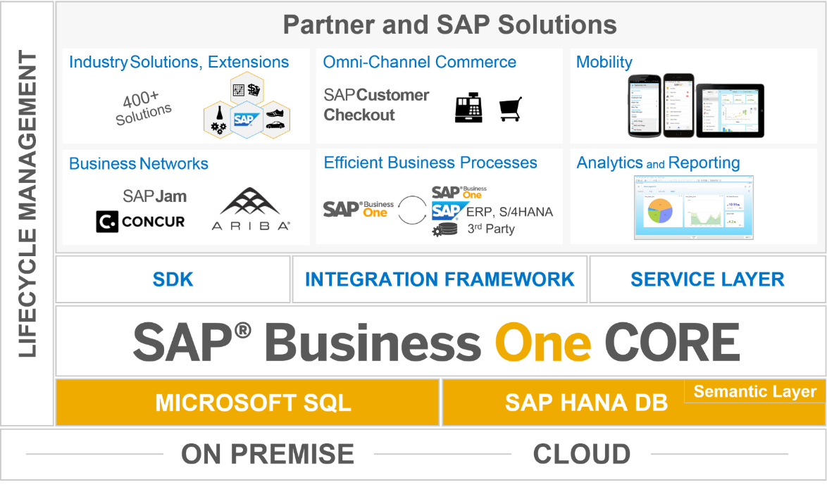
The SAP Business One Solution Stack
Low cost of ownership
and support
Expands the solution scope
Robust integration and collaboration
Extensibility
Interface for
SAP HANA apps
Covers all standard
business processes
Runs on in-memory
technology
Deployment flexibility
Notes:
Deploy on premise or cloud
Sql or hana
Business one is the core
Dev extensions (add ons)
Flexibility of deployment.

Slide 12

Key Functionality
Make decisions with real-time insights
Business collaboration via integrated business functions
Compete effectively within the digital economy
Grow your business with best-practice processes
Financials
Analytics
Purchasing
Sales
Service
CRM
Project Management
Production and inventory management
Integrated on-premise and cloud solution
Production
MRP
Reporting
Opportunities
Inventory
+ Solution Extensions
Notes:
Dashboards, SAP mobile apps, outsourced payroll, automated request for quotation, integration of web-based SAP Customer Checkout application, Ariba Network integration (purchase order and invoice automation), SAP Hybris Cloud for Customer (best practice for sales side)
Project Management, Service, MRP

Slide 13

SAP Business One Deployment Options; On-premise and Cloud
On premise
Cloud
Key Benefits
Compliance with your own internal Data Security Policies Direct control and access to your data, allowing flexibility in local reporting accesses Better ability to customize and extend your business process Leverage off existing internal hardware and IT infrastructure and resources Perpetual licensing, with higher upfront cost but better long-term TCO Less dependence on always connected internet connections
Key Benefits
Secure browser-based access from anywhere, at any time Easy and affordable deployment Get the latest functionality of the SAP Business One application with reduced up-front costs and minimal IT overhead. Access to the most up-to-date functionality without having to use rely on in-house IT resources to maintain the solution. Subscription licensing avoiding capital expenditure and allowing for operational expenditure flexibility Manage your most critical business functions in your Web browser.
Notes:
Side by side pros and cons of each, or why you’d chose one over the other

Slide 14
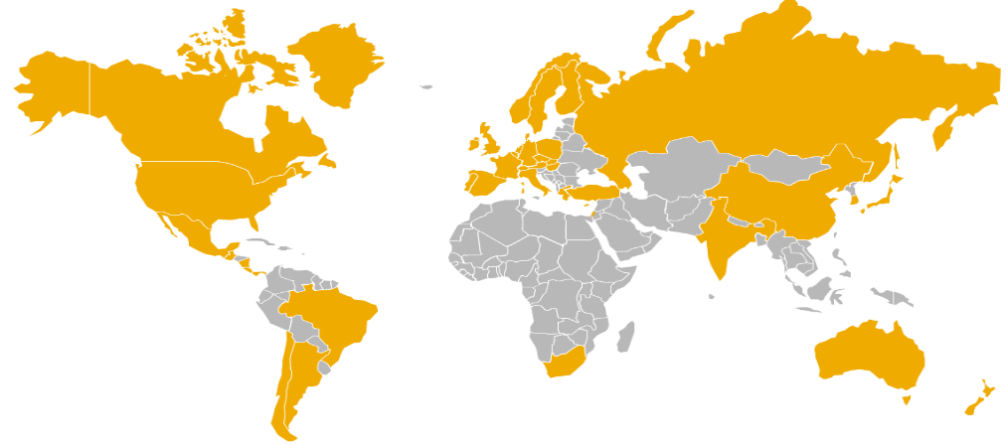
Used in 170+ countries, with 43 country specific localizations
 | Current localizations (43)
Argentina |  | Denmark | Italy | Singapore
Australia |  | Finland | Japan | Slovakia
Austria |  | France | Mexico | South Africa
Belgium |  | Germany | Netherlands | South Korea
Brazil |  | Greece | New Zealand | Spain
Canada |  | Guatemala | Norway | Sweden
Chile |  | Hong Kong | Panama | Switzerland
China |  | Hungary | Poland | Turkey
Costa Rica |  | India | Portugal | United Kingdom
Cyprus |  | Ireland | Puerto Rico | United States
Czech Republic |  | Israel | Russia
 | Countries making use of existing localizations
Customers in 110+ countries use localizations of other countries, own customization or partner solution
Languages solution currently translated to (27)*
Arabic, Chinese (simplified), Chinese (traditional), Czech, Danish, Dutch, English (UK), English (US), Finnish, French, German, Greek, Hebrew, Hungarian, Italian, Japanese, Korean, Norwegian, Polish, Portuguese (Brazil), Portuguese, Russian, Slovak, Spanish (Latin America), Spanish, Swedish, Turkish
* There are several convenient options to make additional languages available. One option is using a partner solution, for some countries these are bundled with functional add-ons. Another simple option is to define customer specific UI language terms using the Custom Language Tool as detailed in SAP note 1757764.

Slide 15
Run your business anytime, anywhere with native apps

Slide 16


Make real-time business decisions with Business Apps and Analytics
HANA Apps
Analytics and Reporting
HANA Apps
Find any information within your organization with Enterprise Search, just like searching on an internet search engine! Customize and create new analytics with the Pervasive Analytics designer, amplifying the end user experience Make informed decisions instantly with the Cash Flow Forecast app, ensuring healthy liquidity ratios With the Available-to-Promise app you can interact with current and future stock levels to ensure that you can satisfy your customer demands The Delivery Schedule management app allows you to prioritize customers orders via a drag-and-drop interface, ensuring on-time delivery to your key customers Implement lean inventory management techniques with the Intelligent Forecast app thus improving efficiency and increasing profits
Analytics and Reporting
With the Interactive Analysis you can create flexible ad-hoc analysis within the familiar Microsoft Excel application Tap into our Semantic Layer, aiding end users to access information freely, using common business terms With the Excel Report designer, create predefined Microsoft Excel reports with a real-time connection to your business data Embed Dashboards across all business forms and functions empowering end users with up-to-the-second information Track business-critical measures with Key Performance Indicators (KPIs) all visible within your user specific Cockpit Generate and create feature rich and interactive reports with the embedded SAP Crystal Reports

Slide 17
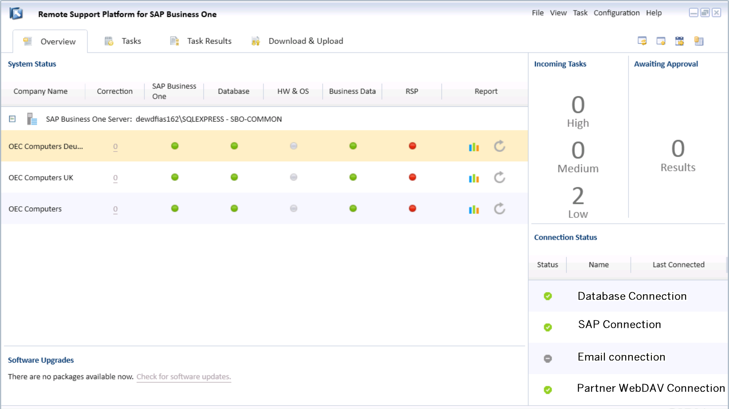
Reduce Maintenance Costs and Mitigate Risks
With Remote Support Platform
RSP can proactively monitor the health status and integrity of customer databases and send the results to SAP and Partner support which are then able to notify customer administrator about known issues. RSP also allows an automatic correction of databases via the execution of corrective tasks.
Key Benefits
Proactively avoid business standstills Faster upgrade due to the pre-upgrade service that checks if your system is ready to upgrade Decreased time for support resulting in faster return on investment (ROI Proactive detection of potential issues with impact on business Automatic back-up functionality embedded
Notes:
Monitoring system – hw to proactively check system

Slide 18
SAP Business One Key Functionality
SAP Business One Client
Mobile
Analytics/Dashboards
Multilingualism/Localizations
Financial Management | Sales and Marketing | Service and Project Management | Purchasing and Supply Chain Management | Production Planning and Inventory Management | Production
Chart of accounts
Journal entries
Posting templates
Recurring postings
Exchange rates in multiple currencies
Financial reports
Budget mgmt
Cost accounting
Multiple posting periods
Incoming payments
Outgoing payments
Payment run
Bank statement processing
Checks
Credits
Deferred payments
Account reconciliation
DATEV / ELSTER
Fixed Assets
Multi-branch
SEPA
Opportunity and
pipeline mgmt
Contact mgmt
Activities mgmt
Calendar
Campaign mgmt
Blanket agreements
Quotations
Purchase orders
Deliveries
Returns
Invoices
Dunning
Price lists in multiple currencies
Special prices
Period and volume discounts
Customer mgmt
Gross profit calculation
Microsoft Office integration
Service mgmt
Service planning
Tracking across multiple customer interactions
Equipment card handling
Service Dashboards
Service contracts
Mobile Interaction
Recurring transactions
Human resource integration
Knowledge database
Service calendar
Service call processing
Purchase request
Purchase quotations
Web-enabled RFQ
Purchase orders
Goods receipt POs
Goods returns
A/P Invoice
A/P Reserve Invoice
Down-payment Invoice/Request
Cancel Marketing Documents
A/P credit memos
Landed costs
Intrastat
Import Process
Workflow
Resources
Item mgmt
Item lists
Price lists
Goods receipts
Goods issues
Inventory transactions
Transfers
Serial number mgmt
Batch number mgmt
Pick and pack
Recurring transactions
Inventory Tracking
Bin Location
Multiple Measurements
Inventory Counting
Bills of material
Item Sets
Production orders
Goods issues
Goods receipts
Production Dashboards
GL Account Determination
Life Cycle mgmt
Item cost calculation
Forecasts
MRP
Drop Ship
Make to order
Resource
Order recommendations

